Slide 1
Secure Data Hiding in Image Using Steganography
CAPSTONE PROJECT
Presented By : Ritesh Sahare
College Name & Department : Anjuman College Of Engineering and Technology ,Department of Computer Science And Engineering

Slide 2
OUTLINE
Problem Statement
Technology used
Wow factor
End users
Result
Conclusion
Git-hub Link
Future scope

Slide 3
Problem Statement
This project will safely embed information in images through steganography, so only approved users will be able to decrypt it with a designated password. The system will insert confidential data without noticable alterations to the image, offering a safe and secret means of transmitting data.

Slide 4
Technology used
Python – The primary programming language for implementing steganography.
OpenCV – Used for image processing, modification, and extraction of hidden data.
NumPy – Helps with efficient manipulation of image matrices for embedding and extracting data.
OS Module – Manages file operations like reading, writing, and navigating directories.
File Handling – Used to read the secret data, embed it into images, and extract it securely using a password.

Slide 5
Wow factors
Password-Protected Decryption – Only users with the correct password can extract hidden data, adding an extra layer of security.
LSB-Based Steganography with Encryption – Data is not only hidden within an image using the Least Significant Bit (LSB) method but also encrypted before embedding, ensuring double security.
Minimal Image Distortion – Uses optimized encoding techniques to ensure that the image quality remains nearly unchanged, making detection difficult.
Automated File Handling – Uses Python’s OS module for smooth reading, writing, and retrieval of encrypted hidden data from images

Slide 6
End users
Cybersecurity Professionals – For secure data transmission without detection.
Government & Defense Agencies – To send confidential messages securely.
Journalists & Whistleblowers – For safe communication in restricted environments.
Corporate Organizations – To protect sensitive business information.
Forensic Experts – For secure data storage and retrieval in investigations.
Individuals & Privacy Enthusiasts – For personal data protection and secure file sharing.

Slide 7
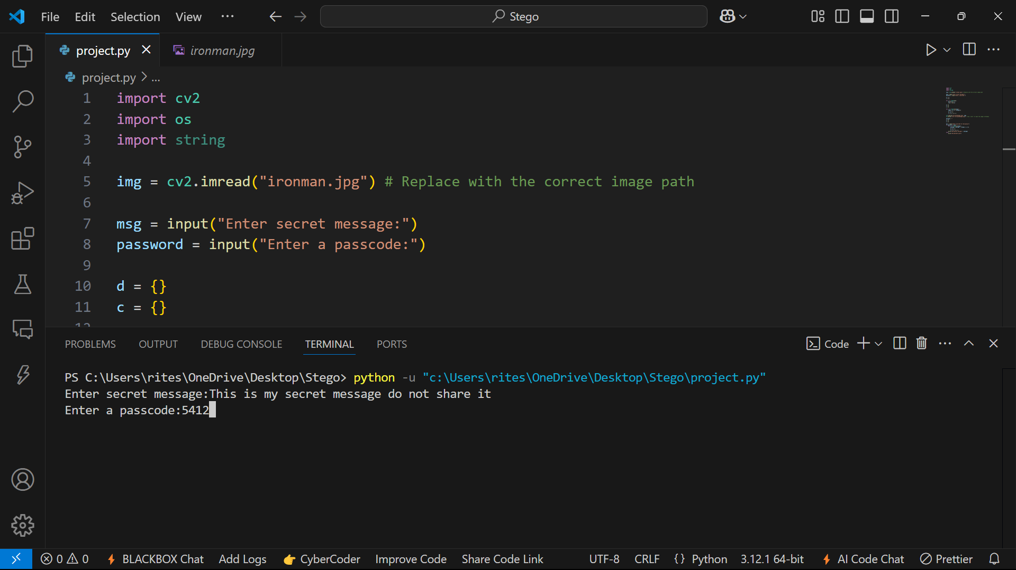


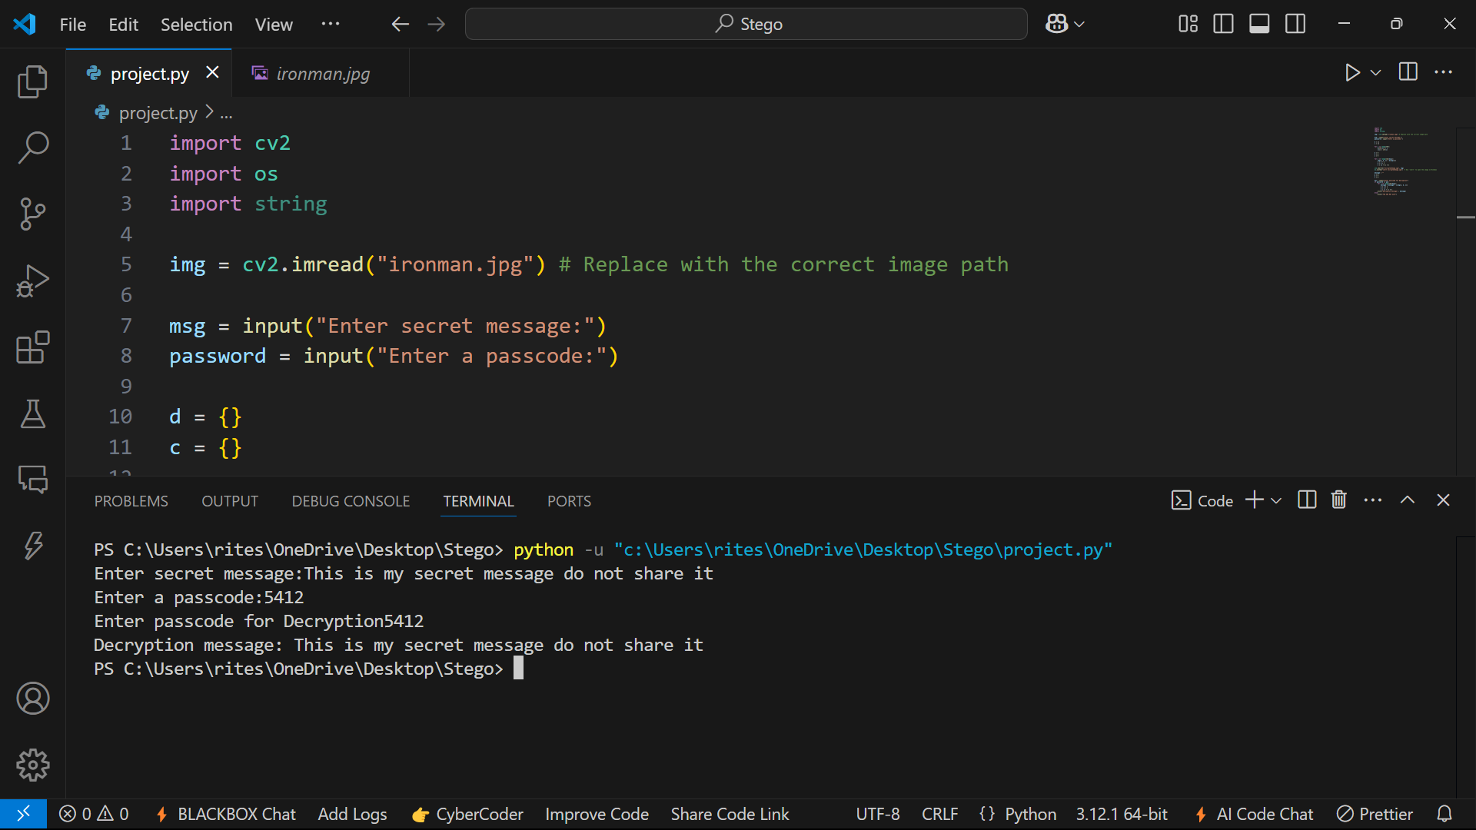
Results
Original Image
Encrypted Image

Slide 8
Conclusion
This project successfully implements a secure data hiding technique using steganography, ensuring confidentiality through password-protected decryption. By leveraging Python, OpenCV, NumPy, and file handling, it provides an efficient and undetectable method for embedding encrypted data within images. The system enhances data security while maintaining image quality, making it suitable for various applications in cybersecurity, corporate communication, and privacy protection. This approach ensures safe and hidden data transmission, reducing the risk of unauthorized access

Slide 9
GitHub Link
https://github.com/Ritesh-codes1/Stegnography_image.git

Slide 10
Future scope(optional)
Advanced Encryption – Implement stronger encryption algorithms for enhanced security.
AI-Based Steganography – Use machine learning to optimize data hiding and detection resistance.
Real-Time Applications – Develop mobile or web-based secure messaging platforms.
Multi-Format Support – Extend support to video and audio steganography.
Cloud Integration – Enable secure hidden data storage and retrieval over the cloud

Slide 11
THANK YOU

